Slide 1
From Chaos to Knowledge: Organizing Your Research with Obsidian, Zotero, and Git
Rohan Rahatgaonkar
Python Coffee | IA-PUC

Slide 2
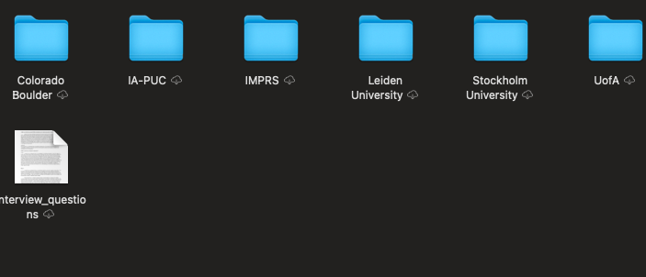
Your Research Brain is Overflowing
50+ papers read but where are your notes?
Key results buried in random files
Same idea scattered across 5 different documents (multiple rewrites and revisions of same idea for scholarship applications, have to organize the computer so you can find stuff, create 100s of word documents not connected..)
"Did I read this already?" (yes, 3 months ago), where are the notes, oh on my computer..
Collaborators can't find what you're working on.

Slide 3
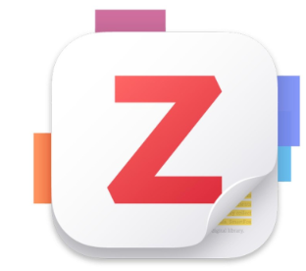
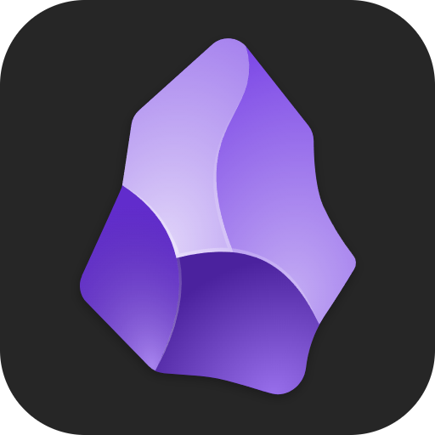

Three Tools, One Unified System
Zotero = Your reference database (organize papers + annotate)
Obsidian = Your note-taking brain (connect ideas + write)
Git = Your backup + collaboration (sync everywhere)

Slide 4
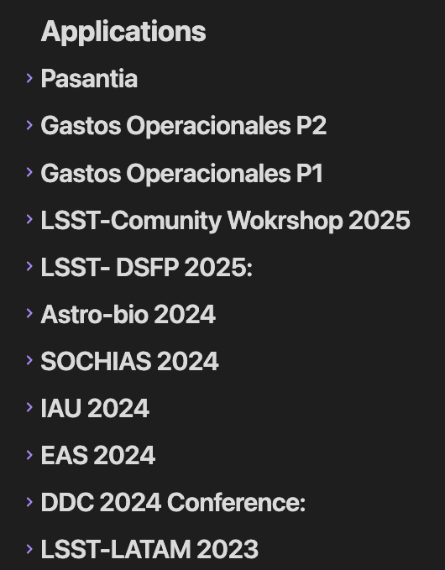
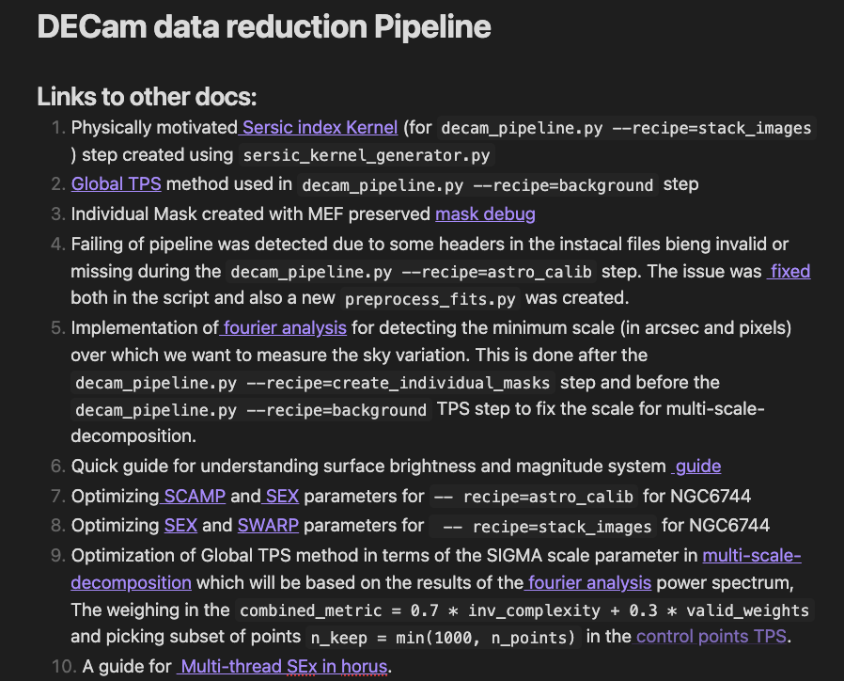
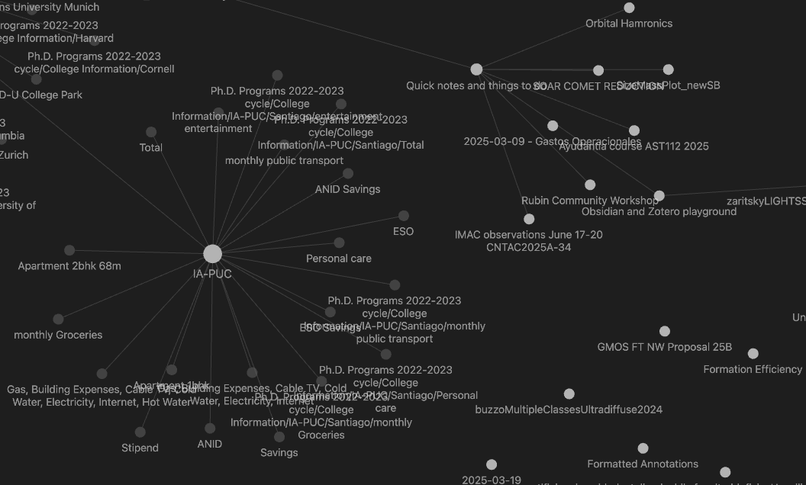
What is Obsidian?
A markdown-based note-taking app (free, stores files locally on your computer)
Uses bidirectional linking - connect notes together like a knowledge graph.
Distraction-free writing environment.
Plugins expand functionality (Zotero integration, Git sync, etc.)

Slide 5
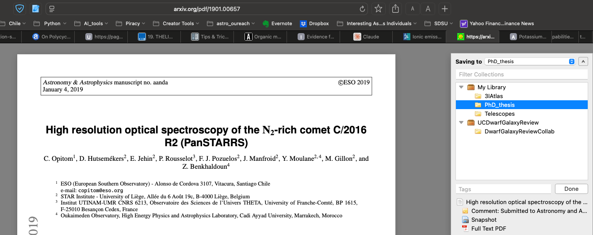
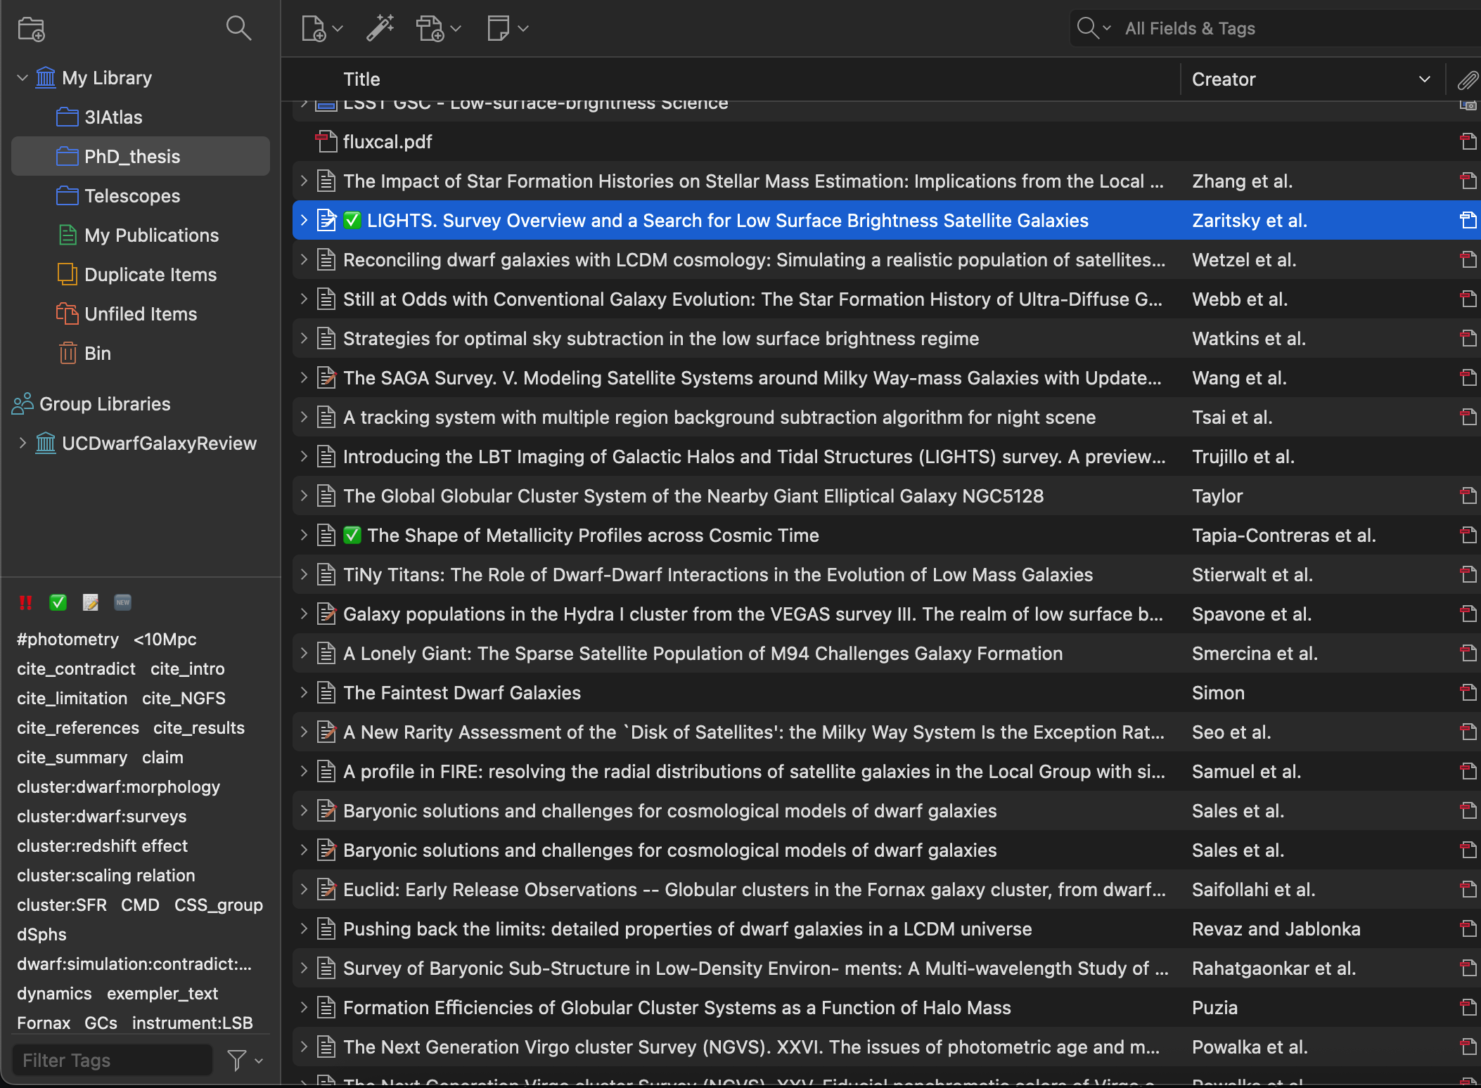
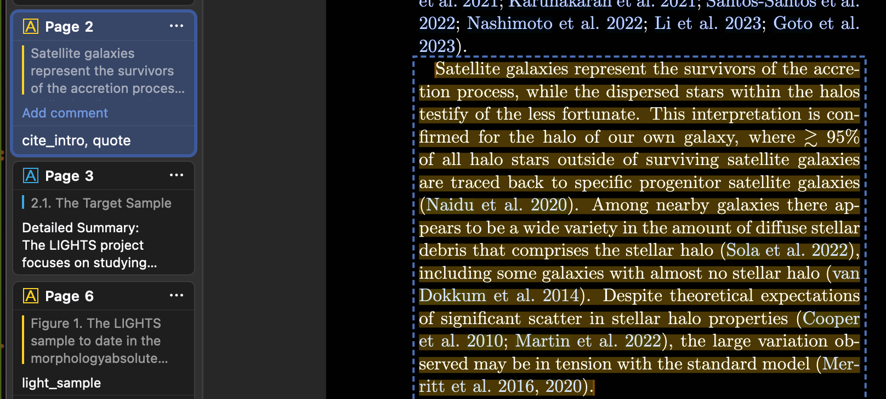
What is Zotero?
Reference manager that stores all your papers
Drag and drop PDFs or use browser extension to auto-import
Read and annotate PDFs inside Zotero (highlight, add notes)
Organize by collections/tagsExport citations in any format (APA, Chicago, Nature, etc.)

Slide 6
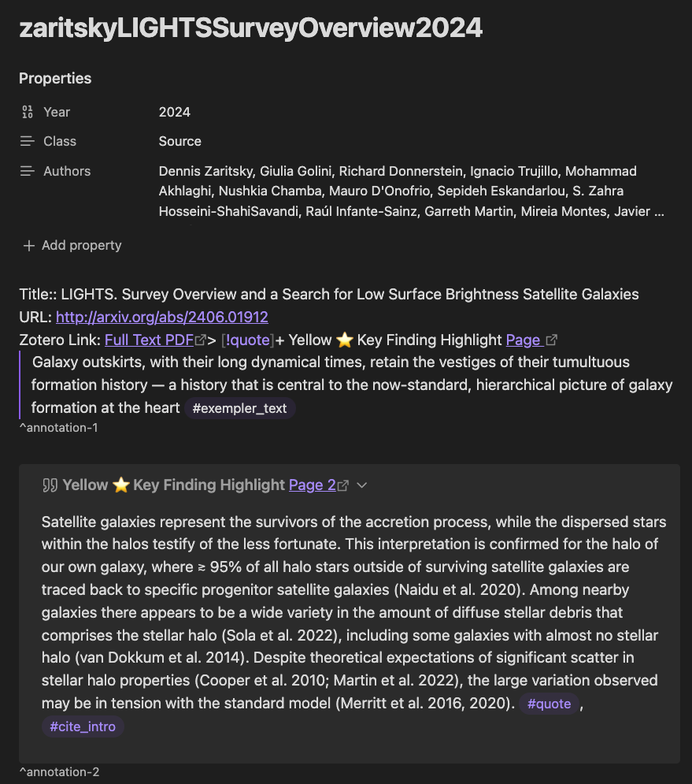
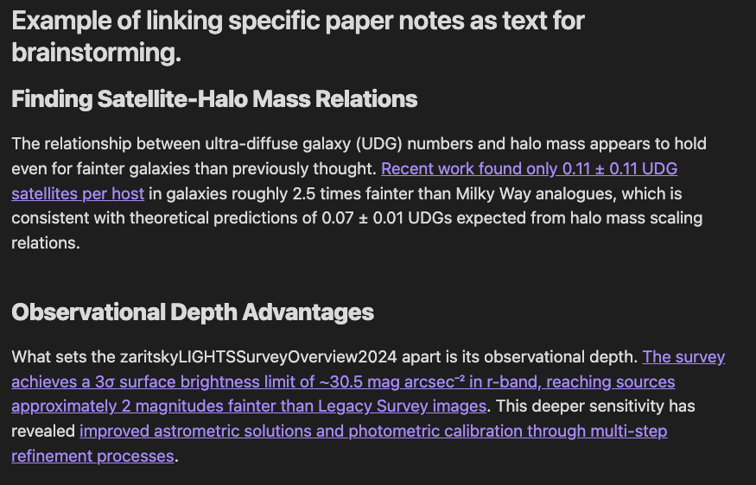
The Magic: Import Your Annotated Notes
Use Zotero Integration plugin in Obsidian
Press hotkey → search for paper → imports all your highlights + notes
Each highlight gets a unique link anchor (^annotation-1, ^annotation-2)
Creates a "literature note" with all your annotations organized

Slide 7
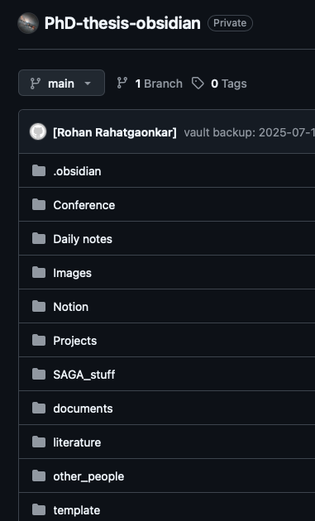
Getting Started: From Zero to Connected Step 1: Set Up Git
Create a GitHub Account (if you don't have one)Go to github.com
Sign up (free)
Create a New RepositoryClick "New Repository"
Name it something like "my-research-vault"
Make it Private (keep your notes private)
Initialize with README
Create Repository
Clone It to Your ComputerOpen terminal/command prompt
Run: git clone https://github.com/YOUR-USERNAME/my-research-vault.git
This creates a folder on your computer
This folder will become your Obsidian VaultYou'll store all your notes here
Everything auto-syncs to GitHub

Slide 8
Getting Started: From Zero to Connected Step 2: Set up Zotero
1. Download Zotero
  Go to zotero.org
  Download and install for your OS (Windows/Mac/Linux)
Install Browser Extension
  In Zotero, go to Tools > Add-ons
  Search for your browser (Chrome, Firefox, Safari)
  Install the Zotero Connector extension
  This lets you save papers to Zotero from any webpage
Add Your First Papers
  Drag and drop a PDF into Zotero, OR
  Use the browser extension to save papers from arXiv/journals
  Zotero auto-extracts title, authors, date
Annotate a Paper (Practice)
  Open any PDF in Zotero
  Highlight text with your mouse
  Add color labels (red, yellow, blue, etc.)
  Add notes by right-clicking highlights
  These will import into Obsidian later

Slide 9
Getting Started: From Zero to Connected Step
Step 3: Download Obsidian & Install Plugins
1. Download Obsidian
Go to obsidian.md
Download and install for your OS
When it opens, click "Open folder as vault"
Select the Git folder you cloned earlier
This is now your vault!
2. Enable Community Plugins
Open Settings (gear icon, bottom left)
Left sidebar: Click "Community plugins"
Click "Turn on community plugins" (if it says "Safe mode" click "Disable")
This lets you install third-party plugins
3. Install Zotero Integration Plugin
Still in Community plugins, click "Browse"
Search: "Citations" (by Jon Gauthier)
Click Install
Toggle it ON
Go back to Settings and look for "Citations" in the left sidebar
4. Install Obsidian Git Plugin
Browse community plugins again
Search: "Obsidian Git"
Click Install
Toggle it ON
This lets you sync with GitHub automatically
5. Install Better BibTeX in Zotero
(Required for Citations to work)In Zotero, go to Tools > Add-ons
Search for "Better BibTeX"
Install it
This creates citation keys like "Smith_2023" for your papers

Slide 10
GETTING STARTED: FROM ZERO TO CONNECTED
Download Obsidian & Install Plugins
1
Download Obsidian
4
Install Obsidian Git Plugin
Go to obsidian.md and download for your OS
When it opens, click "Open folder as vault"
Select the Git folder you cloned earlier — this is your vault!
Browse community plugins → Search "Obsidian Git"
Click Install → Toggle ON
This lets you sync with GitHub automatically
2
Enable Community Plugins
5
Install Better BibTeX in Zotero
Open Settings (gear icon, bottom left)
Left sidebar → Click "Community plugins"
Click "Turn on community plugins" (disable Safe mode if needed)
Required for Citations plugin to work
In Zotero: Tools → Add-ons → Search "Better BibTeX"
Install it — creates citation keys like "Smith_2023"
3
Install Zotero Integration Plugin
💡 Order Matters
In Community plugins, click "Browse" → Search "Citations" (Jon Gauthier)
Click Install → Toggle ON
Go to Settings and look for "Citations" in the left sidebar
Install Better BibTeX in Zotero before configuring the Citations plugin in Obsidian — otherwise it won't detect your library correctly.
10/24/25
Rohan Rahatgaonkar
9

Slide 11
Key Takeaways
Obsidian = Your organized research brain (bidirectional linking, markdown, local files)
Zotero = Your paper library + annotations (organize, highlight, export)
Git = Your safety net + everywhere access (backup, sync, version history)
Together = No more chaos, systematic knowledge building
Free + Open Source = It's yours forever, no vendor lock-in (most importat)
Bonus = If you currently use Notion, Evernote or something, you can easily import them!

Slide 12
This is Both Art and Science - Make It Your Own
Important: This system can get complex and deeply personal. Don't be intimidated!
Everyone's vault looks different because everyone's brain works differently. Your organization system should reflect:
How you naturally think about topics
Your research workflow
Your personal preferences
Some people organize by:
Topic/theme (e.g., #stellar-halos, #dark-matter, #simulation)
Paper type (observation, theory, method)
Project (PhD Chapter 1, Conference Talk, etc.)
Chronological (when they read it)
Hybrid approach (mix and match)
There is no "right way" - there's only what works for YOUR brain.

Slide 13
This is Both Art and Science —
ORGANIZE BY
Make It Your Own
# Topic / Theme
#stellar-halos, #dark-matter
Important: This system can get complex and deeply personal. Don't be intimidated!
📄 Paper Type
observation, theory, method
Everyone's vault looks different — your system should reflect:
📁 Project
🧠
How you
think
🔬
Your research
workflow
✨
Your personal
preferences
PhD Chapter 1, Conference Talk
📅 Chronological
when you read it
There is no "right way" —
there's only what works for YOUR brain.
🔀 Hybrid
mix and match!
10/24/25
Rohan Rahatgaonkar
11

Slide 14
Learning Resources (YouTube, Guides, Communities)
Youtube resources:
  Obsidian git setup: https://youtu.be/5YZz38U20ws?si=aE7lh31vCtp1z-DR
  Zotero with obsidian: https://youtu.be/xG0TMhB03aE?si=lWzleV4YdjTl1-YM
  Research methodology, zettelkasten system: https://youtu.be/ScXGpZRZ7Ck?si=27MNeJSvWyezeMGv
Article: https://medium.com/@alexandraphelan/an-updated-academic-workflow-zotero-obsidian-cffef080addd
Communities:
  Obsidian Forum (https://forum.obsidian.md) - Ask questions, see workflows
  Reddit: https://www.reddit.com/r/ObsidianMD/- Share setups, ask for advice
Local AI Implementation:
  https://youtu.be/2paigpNDNz0?si=zot_6VHZNcWWf3TC

Slide 15
Questions?

